Slide 1


Towards a Model for Predicting Overland Trafficking Routes Cornell, Harry Necaise, Aaron Robkin, Jessica IDS 6916 Research Practicum Final Presentation

Slide 2
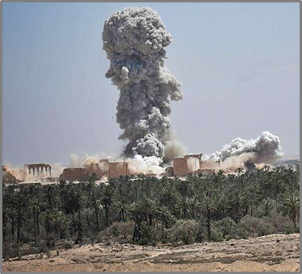
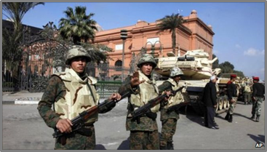

Introduction - Terrorism and the Theft of Cultural Heritage
Regional background
Arab Spring & Syrian Civil War in 2011 leads to destruction of cultural heritage sites and museums across the region.
In the intervening years, widespread archaeological site looting by both terrorist and government actors occurs.
Destruction of Palmyra, 2016. Photo: Arbresh.info
Cairo Museum, 2011. Photo: AP/BBC News
Notes:
Since the beginning of the Syrian Civil war in 2011, extremist groups have taken advantage of the chaos and instability to loot and destroy archaeological sites and museums throughout Syria and into parts of Iraq, the most notable widely covered of which have been the 2014-2015 capture of Mosul and subsequent destruction of the Mosul Museum and Library.
In 2015, ISIS took bulldozers and explosives to Nimrud, vandalizing Hatra, Nineveh, Khorsabad, and others. The destruction of Palmyra in 2016 was another devastating blow to world cultural heritage.
While the primary players in this story that we are all familiar with are Al-Qaeda and ISIS, we must not forget the importance of local gangs of organized looters, as well as subsistence looters, that take advantage of inadequately protected cultural property to loot for a variety of reasons.
So, why is this happening?
The reasons why the destruction and looting of cultural property is happening both in the Middle East and across the globe seem to fall into a number of categories.
Failure to protect archaeological sites and cultural property, poverty, religious ideology, propaganda, and last, but most certainly not least, supply and demand, are some of the contributing factors of this issue
Extremist Muslim groups have used religious ideology as a driving motivation for destruction of idolatrous heritage. The Taliban made no qualms about destroying the Bamiyan Buddhas in Afghanistan for just this very reason.

Slide 3
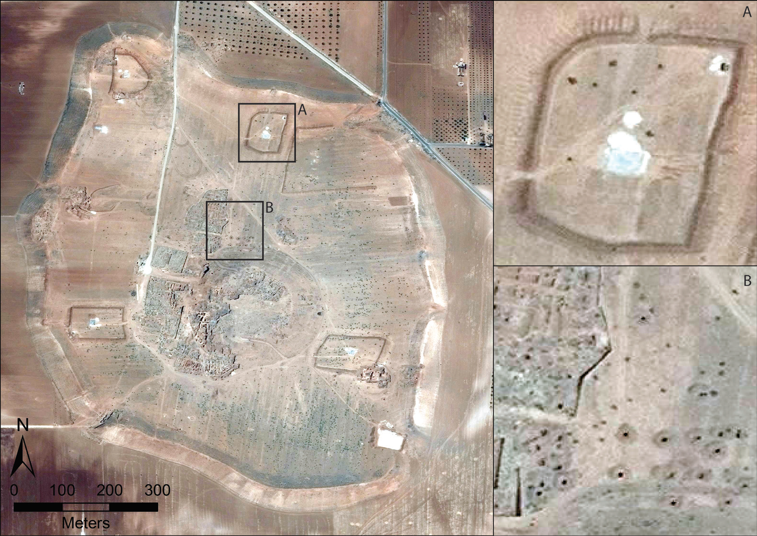
Introduction - Looting and the Funding of Terrorism
ISIS destroys archaeological sites under the premise of idolatry, while confiscating the most valuable artifacts for later sale on the black market.
Evidence of widespread site looting is detected using satellite imagery from the region.
Long-term repercussions of these actions multifaceted
Terrorism funding
Destruction of cultural identity
2014 Satellite imagery of the Bronze Age city of Elba (present day Tell Mardikh (Casana, 2015).
Notes:
Recently, however, the rise of criminal iconoclasm has returned to the world stage with ISIS taking the lead in destruction of idolatrous cultural sites that they say must be eradicated from a true Islamic state. While they preach their message, in reality, they are destroying these sites for propaganda opportunities used to recruit forces and obtain donations from sympathizers to their cause. Poverty plays a role here. The abject poverty in much of the Middle East forces economically deprived villagers not only into the well-paying arms of ISIS, but also into subsistence looting in efforts to support themselves and their families.
Most importantly, one of the primary drivers in this equation is the law of supply and demand. Private collectors, museums and auction houses from the U.S. to the UK and Japan have an insatiable appetite for cultural property. Regardless of the numerous laws in many countries making trade in illicit antiquities a punishable crime, it is often very easy for collectors and museums to work around a lack of provenience. The simple fact is, if there was no demand for these objects, the extremist groups and opportunistic looters would have nowhere to sell their ill-gotten goods and cultural property might be spared.
The long-term repercussions of this theft are multifaceted. The act of looting destroys all archaeological context the artifacts may have had – thereby eradicating much of the information that archaeologist use to understand the where, when, and why questions that arise when trying to reconstruct past lifeways. Further, the funds from the illicit antiquities trade stock the coffers of terrorist organizations, allowing them to continue their missions of chaos and destruction. Additionally, an often forgotten repercussion of these acts is the destruction of the shared cultural identity that these objects and locations represent. The loss of cultural identity destabilizes the very make-up of society, thereby furthering the goals of extremist groups and limiting the abilities of social reconstruction.

Slide 4
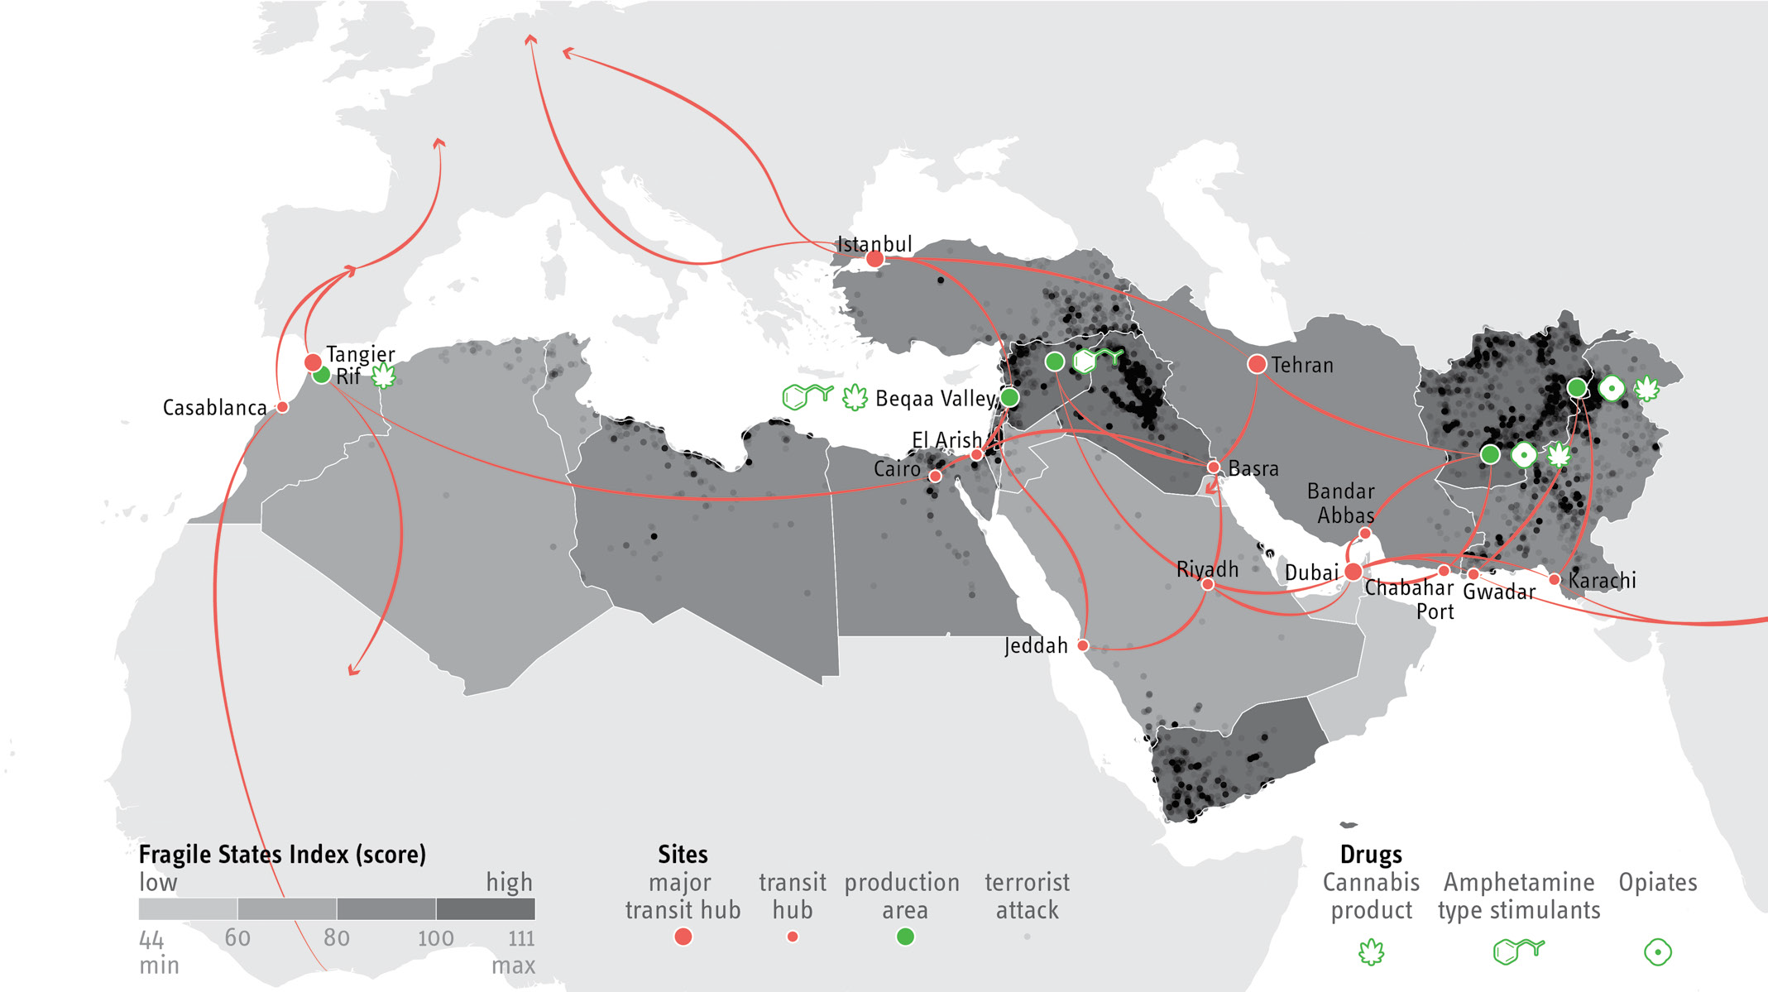
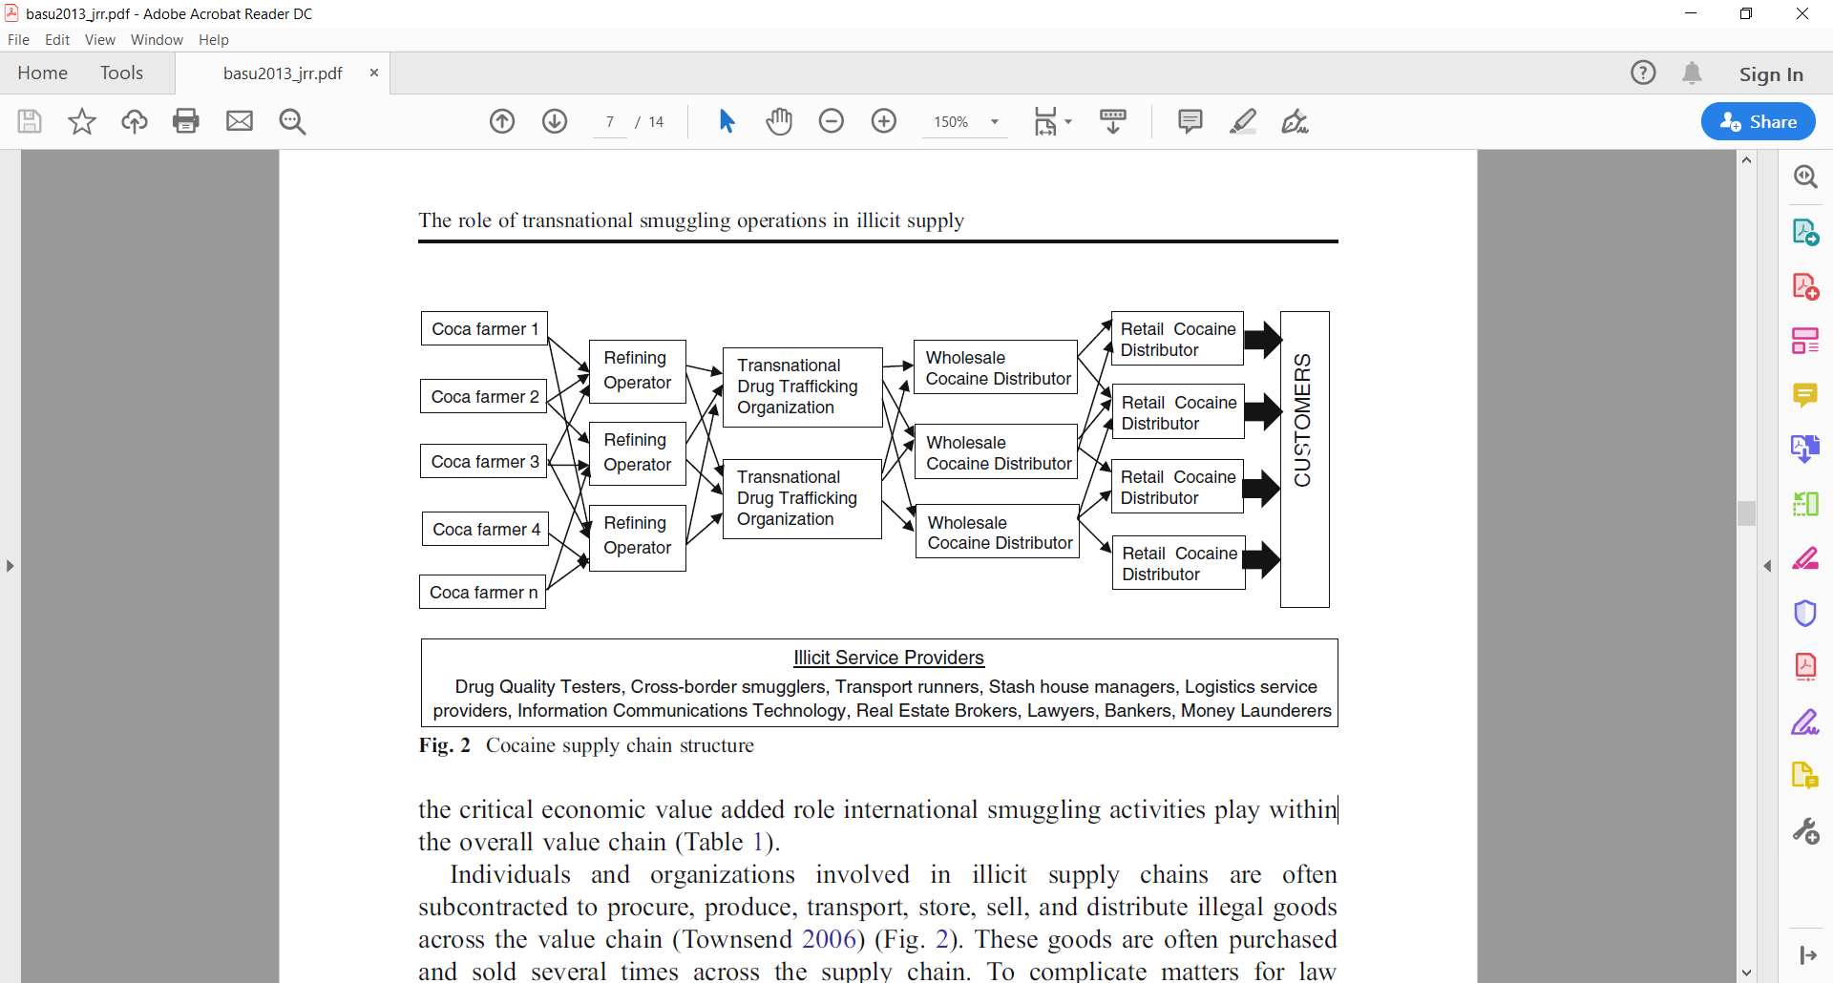
Introduction - Transnational Smuggling and Overland Trafficking
After illicit excavations, artifacts move from local looters to traffickers who transport the goods through road networks, across borders and, eventually, into the black market.
Research into localized and transnational smuggling provide insight into the trafficking of illicit antiquities.
Traffickers often plan out overland smuggling routes, taking several factors into consideration before deciding on the best route to travel.
Trafficking through the Middle East and North Africa (MENA region). (Barzoukas, 2017)
Cocaine supply chain structure (Basu, 2013)

Slide 5
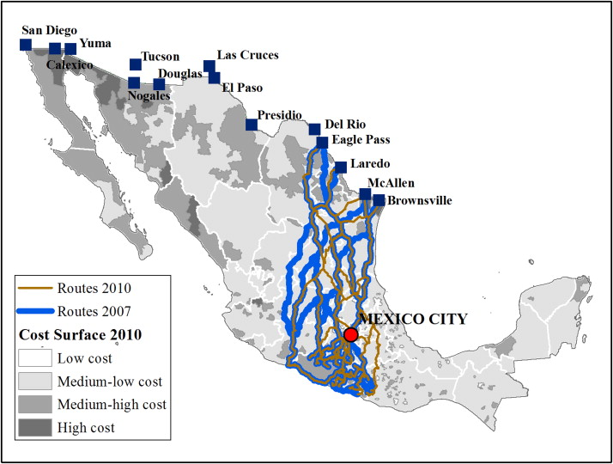
Topic / Purpose Statement
The intent of this line of work is to use computer simulations to help law enforcement and cultural heritage workers recover looted artifacts by identifying the most probable overland smuggling routes.
Predicted drug smuggling routes, MX (Medel, 2015).

Slide 6
Central Research Question
Is it possible to accurately predict the travel patterns of smugglers using computer routing models?
Subtopics:
What factors influence routing decisions and to what degree?
How do these decisions differ across regions?
Can these methods be applied to intercept looted artifacts in the MENA region?
Approach:
Qualitative:
Graph-theory to develop routes
Survey / questionnaires

